Slide 1
LO3 MERIT
LEADERSHIP GROUP PRESENTATATION
Submtted by:
Durga Rao
Indra
Imran
Madhav
Raju
Altaf

Slide 2
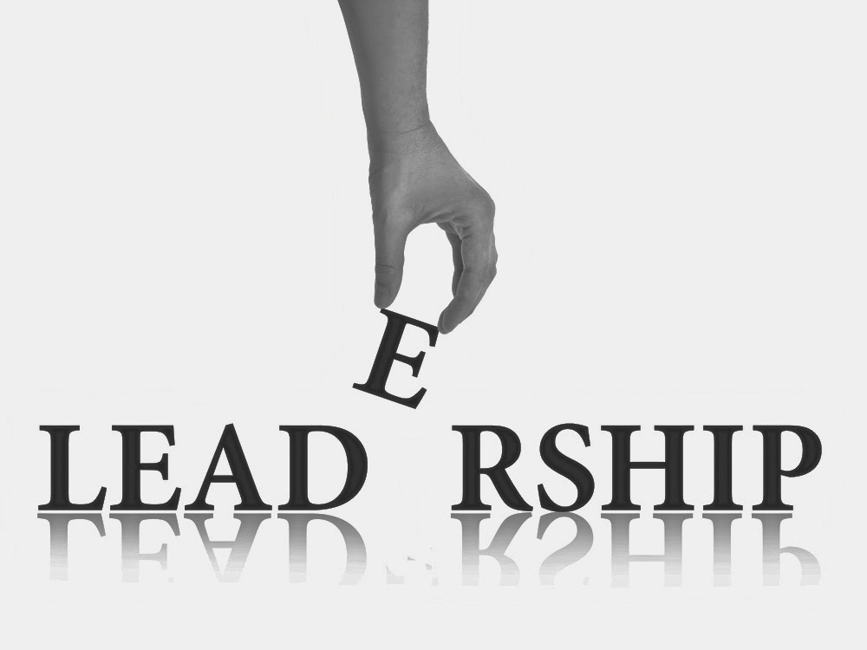
Leadership is the Ability to develop a vision that motivates to move with a passion towards a common goal. So leadership is a process by which person influences others to accomplish an objective and directs organization in a way that makes it more cohesive and coherent.
What is Leadership?
Organizing a group of people or a team to achieve a common goal.
Ability to direct the people in a right direction.

Slide 3
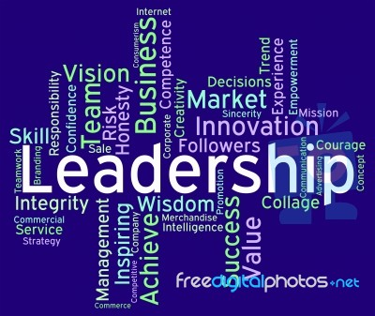

Slide 4
1. Initiates action 2. Motivation 3. Providing Guidance 4. Creating Confidence 5. Co-ordination 6. Effective Planning 7. Inspiration 8. Vision
Leadership qualities

Slide 5

ROLE OF LEADER
A leader’s role always to ensure his/her team achieve the task in hand, but an effective leader also will ensure they meet more subtle requirement.
Leaders are ‘Can-do’ people. They can make their team wants to be ‘like them’. Teams look up to their leaders very much like a child look up their parents. The meaning for this line was it’s good to know you are here…

Slide 6
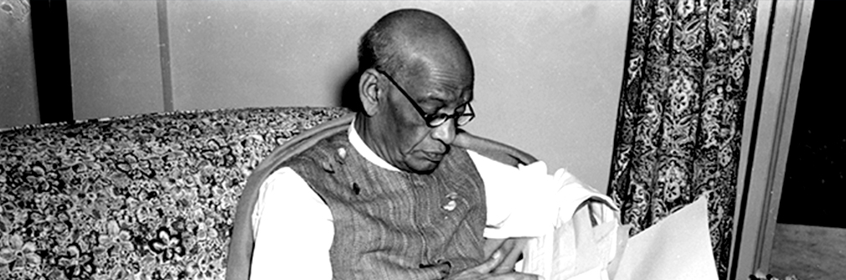
OUR LEADER SARDHAR VALLABHBHAI PATEL

Slide 7
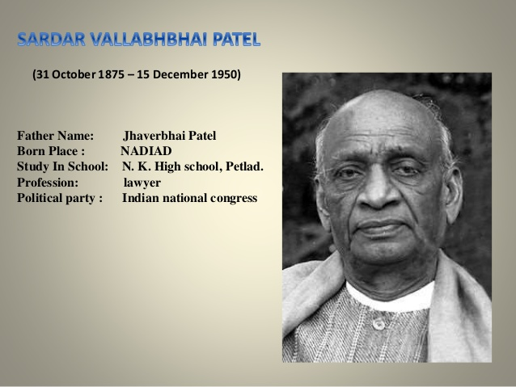

Slide 8
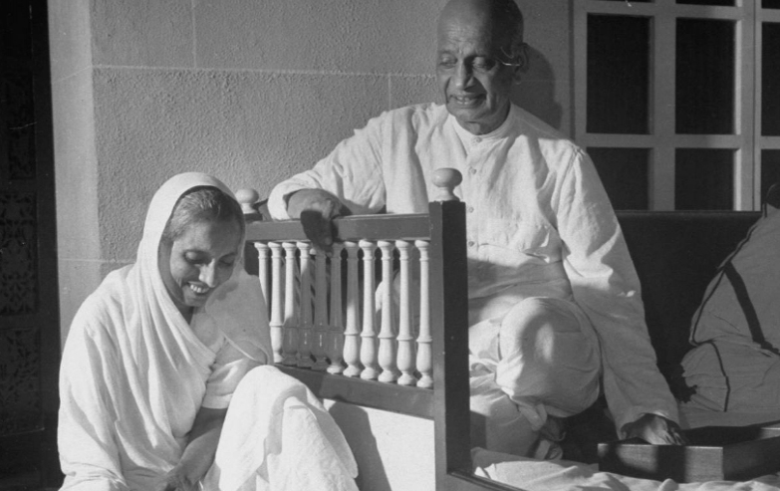
Sardar Vallabhbhai Patel
He was the first Deputy Prime Minister of India. He was an Indian barrister and statesman, a leader of the Indian National Congress and a founding father of the Republic of India who played a leading role in the country's struggle for independence and guided its integration into a united, independent nation. In India and elsewhere, he was often addressed as Sardar.
He was born on 31 October 1875 and he was died in 15 December 1950
His wife name was Jharverba Patel.

Slide 9
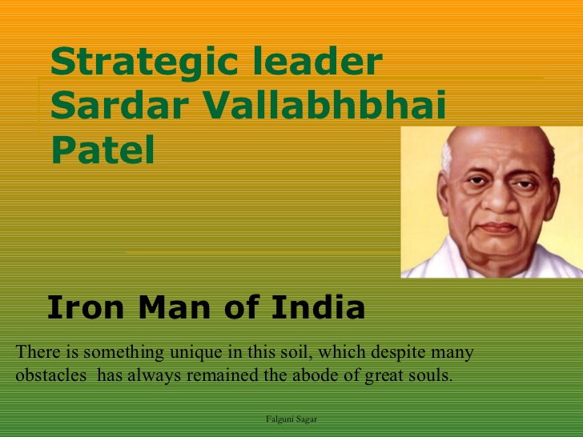
IRON MAN OF INDIA: He also know as Iron man of India and he was a self-educated, forceful and successful Gujarati lawyer, when Born and raised in the countryside of Gujarat, Vallabhbhai Patel he was inspired by the work and philosophy of Mahatma Gandhi.

Slide 10
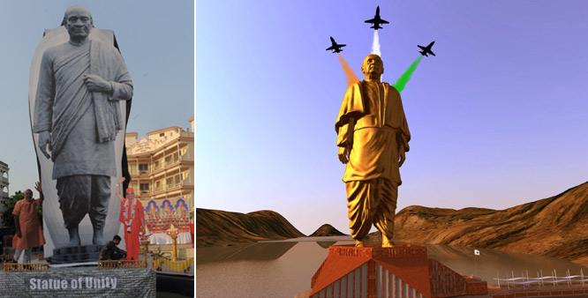
As the first Home Minister and Deputy Prime Minister of India Patel organized relief efforts for refugees fleeing from Punjab and Delhi and worked to restore peace across the nation.
A commemoration of Patel, held annually on his birthday, 31 October, known as the Rashtriya Ekta Diwas (National Unity Day), was introduced by the government of India in 2014.

Slide 11
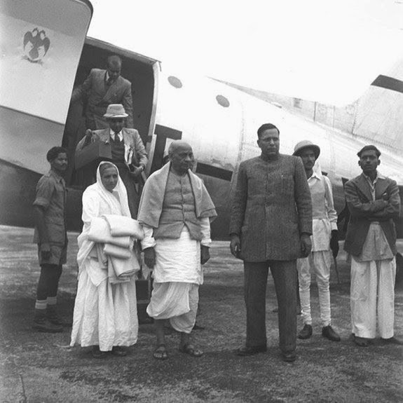
INTEGRATION OF INDIA BY SARDAR PATEL
Patel employed an iron fist in a velvet glove diplomacy; frank political negotiations backed with the option of military action to weld a nation that could emancipate its people without the prospect of divisions or civil conflict. His leadership obtained the peaceful and swift integration of all 565 princely states into the Republic of India. Patel's initiatives spread democracy extensively across India, and re-organized the states to help transform India into a modern federal republic. His admirers call him the Iron Man

Slide 12
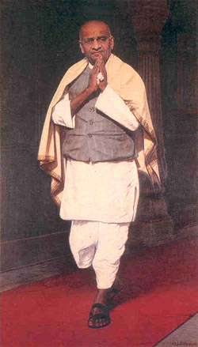
LEADERSHIP SKILS OF SARDAR VALLABHBHAI PATEL
Tenacity :-one the most inspiring strong point of Sardar Patel was his firmness to the goal decided to achieve. His tenacity was indeed incomparable
Invincibility :- After getting freedom, when whole world was thinking that India would be divided in thousands of parts, Sardar Patel was the person who proved them wrong and integrate India

Slide 13
Influence & team building :- One of the most important characteristic of any leader is his influencing ability. Sardar Patel was full of this skill .For e.g.. Organized farmers of Kheda and Bardoli of Gujarat to hold mass- nonviolent civil disobedience first time in India. At that point farmers were not united and was determined to do violent movement against Britishers.
Enthusiasm:- He always produce Zeal, Excitement, Eagerness and Earnestness to bring positive results.
Never ending Winning Spirit :- I have read a book about Sardar Patel’s life, written by Raj Mohan Gandhi, I was motivated by his never ending spirit, dedication to work, loyalty to country, always adapting with group and maintaining balance in group (specially in context of Jawaharlal Nehru)there are so many incidents during his childhood about how he used to go school, his tolerance power etc. which really motivated us.

Slide 14
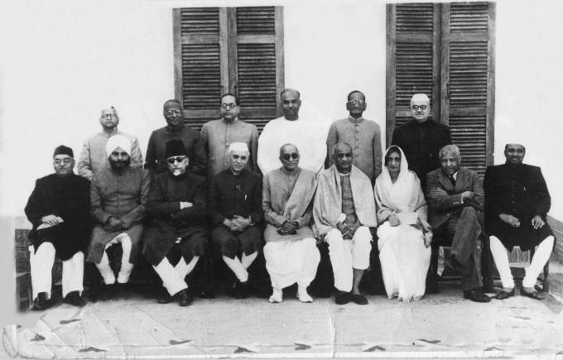
Communication skills:- Listen more, talk less, smile; use positive body language; praise loudly, blame softly are typical leadership communication styles.

Slide 15
THANK YOU

